Slide 1
Research Updates on GNN Species Discovery
Boyuan Yu, Rui Xu
University of Southern California
July 22, 2026

Slide 2
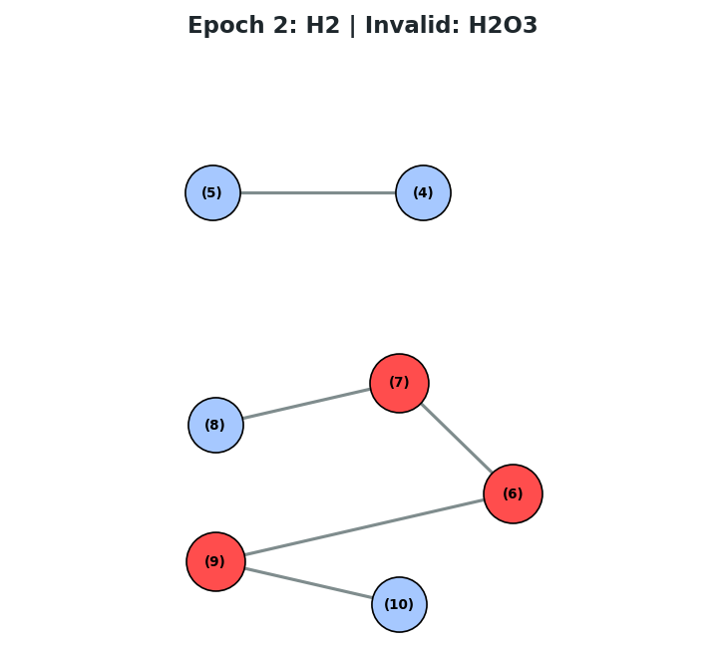
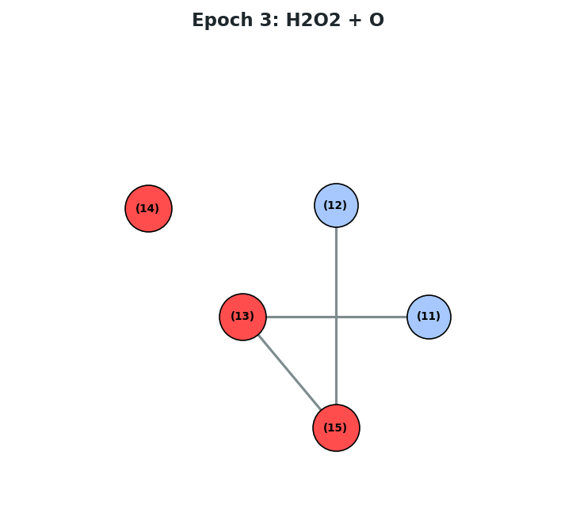
From last time
Achieved: All eight H₂/O₂ species can be discovered using the updated framework.
Invalid species such as hydroperoxyl chain (HO_{x}H, or HO_{x}, x > 3) can still be discovered
H
A valid species “H₂”, give +1.0 reward
O
A valid species “O”, give +1.0 reward
An invalid species “H₂O₃”, give –1.0 reward
A valid species “H₂O₂”, give +1.0 reward

Slide 3
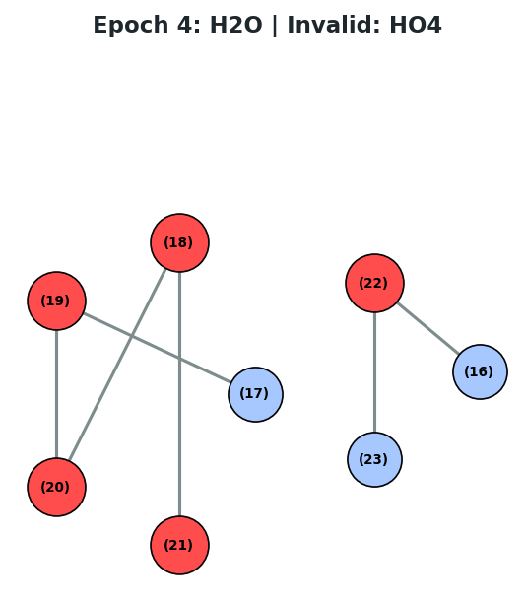
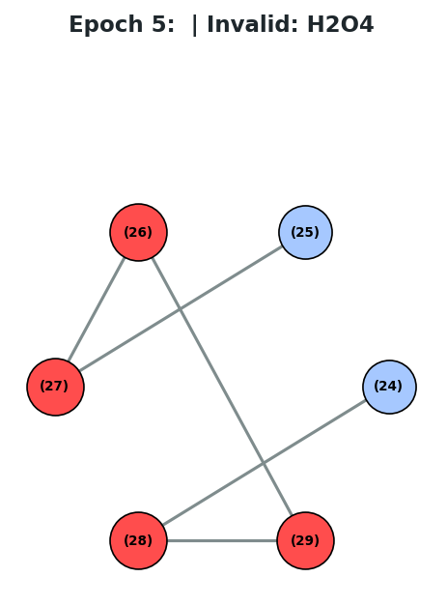
“Invalid species” examples – HO₄ and H₂O₄
H
An HO₄ radical – valid based on the valence rule but invalid as a combustion species
An H₂O₄ molecule – also valid based on the valence rule but invalid as a combustion species
O

Slide 4
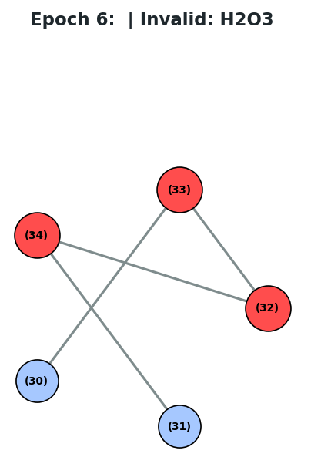
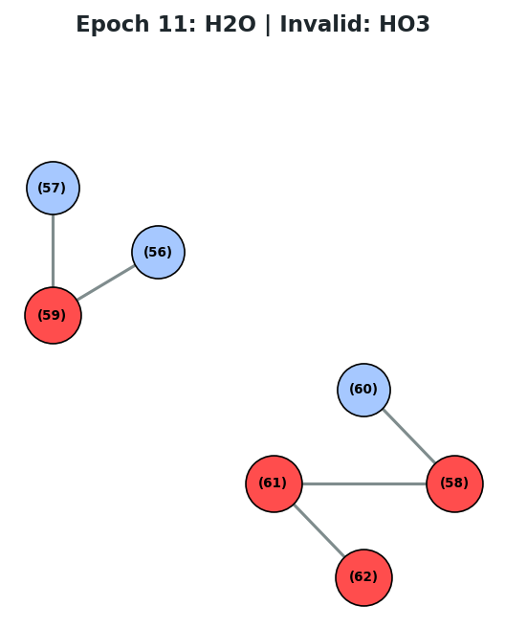
“Invalid species” examples – HO₃ and H₂O₃
H
An H₂O₃ molecule – also valid based on the valence rule but invalid as a combustion species
O
An HO₃ radical – valid based on the valence rule but invalid as a combustion species

Slide 5
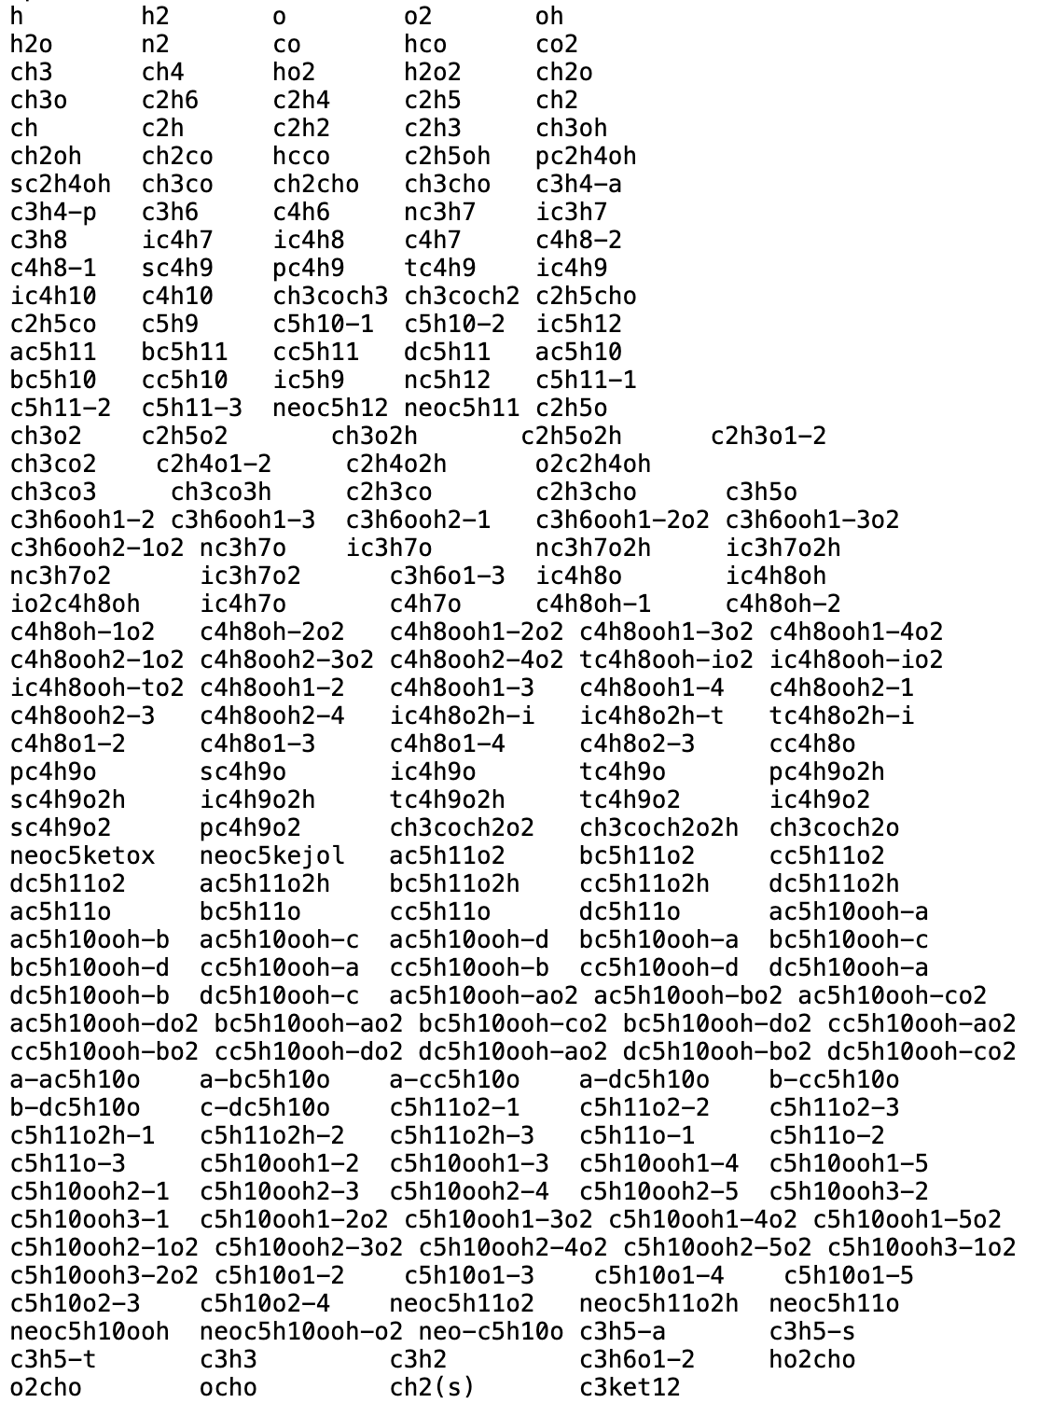
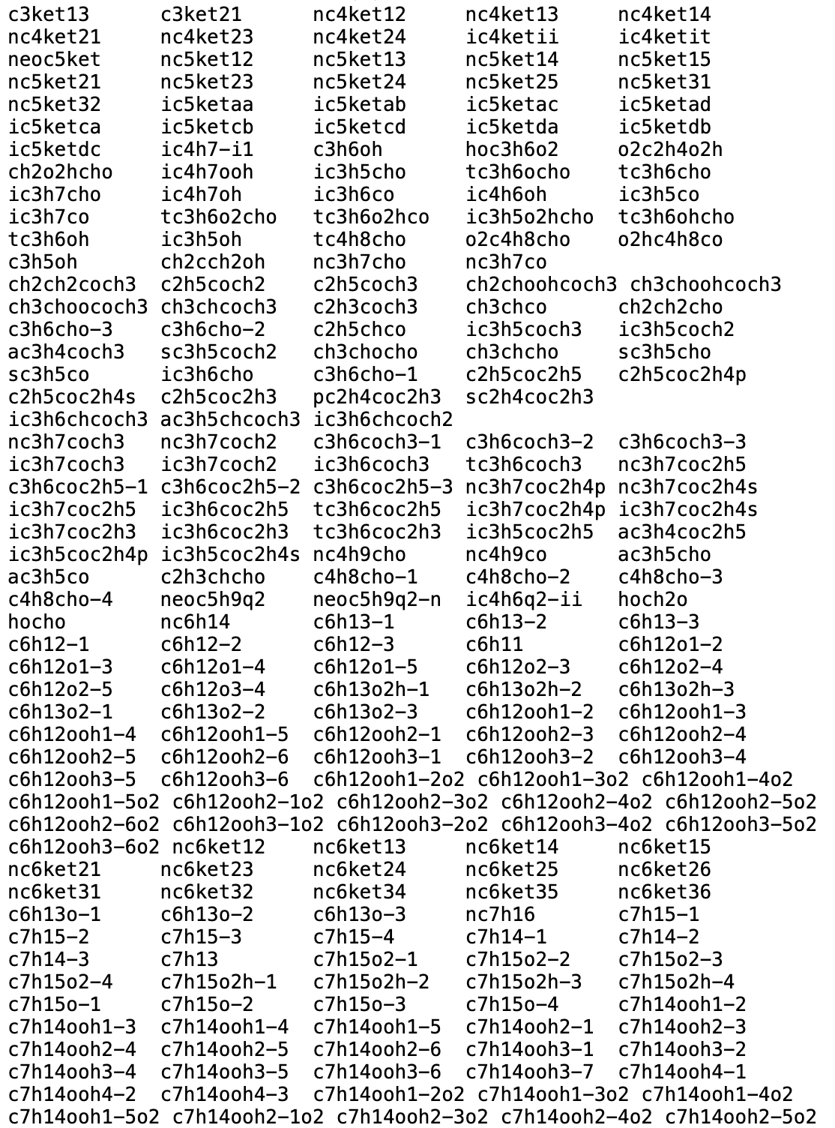
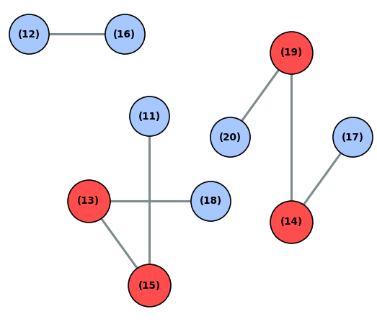


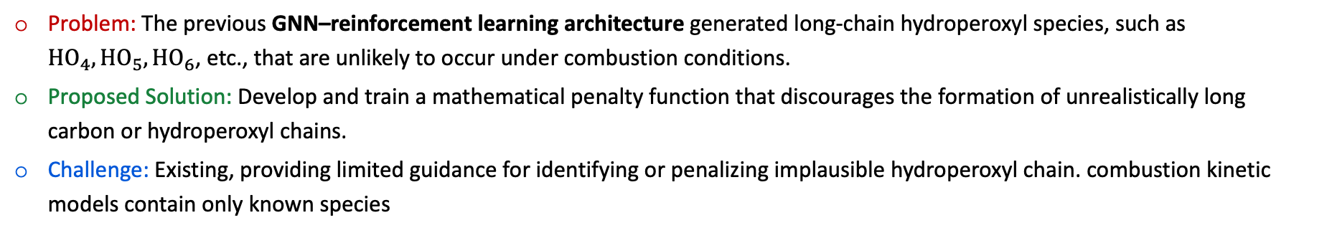
Problem definition
Problem: The previous GNN–reinforcement learning architecture generated long-chain hydroperoxyl species, such as $HO_{4},HO_{5},HO_{6}$, etc., that are unlikely to occur under combustion conditions.
Proposed Solution: Develop and train a mathematical penalty function that discourages the formation of unrealistically long carbon or hydroperoxyl chains.
Challenge: Existing, providing limited guidance for identifying or penalizing implausible hydroperoxyl chain. combustion kinetic models contain only known species
Existing kinetic models
GNN architecture
Inform
Penalize
$$function$$
. . .

Slide 6
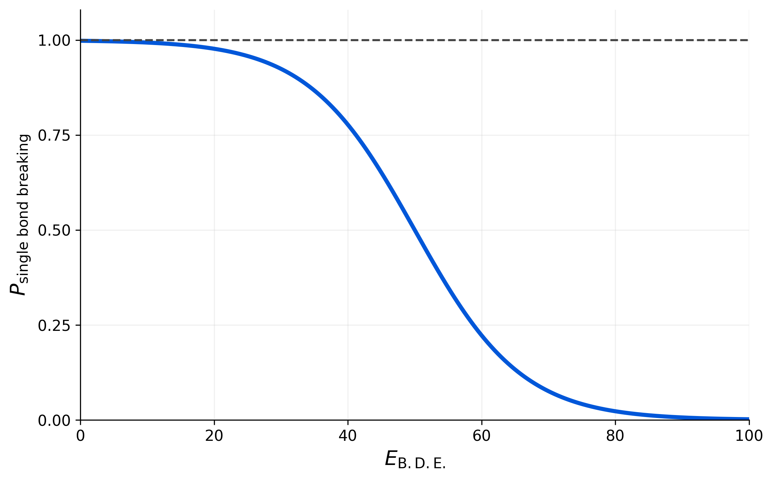
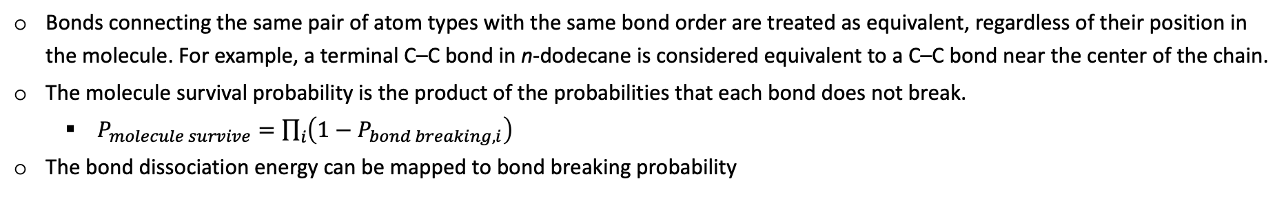
Approach: a simplified mathematical model
Assumptions:
Bonds connecting the same pair of atom types with the same bond order are treated as equivalent, regardless of their position in the molecule. For example, a terminal C–C bond in n-dodecane is considered equivalent to a C–C bond near the center of the chain.
The molecule survival probability is the product of the probabilities that each bond does not break.
$P_{molecule survive}=\prod_{i}{\left(1−P_{bond breaking,i}\right)}$
The bond dissociation energy can be mapped to bond breaking probability
Schematic for the mapping bond dissociation energy (B.D.E) to the probability of single bond breaking:
As B.D.E. increases, the probability of single bond breaking drops.
For low B.D.E., the probability should close to 1.
For high B.D.E., the probability should close to 0.

Slide 7
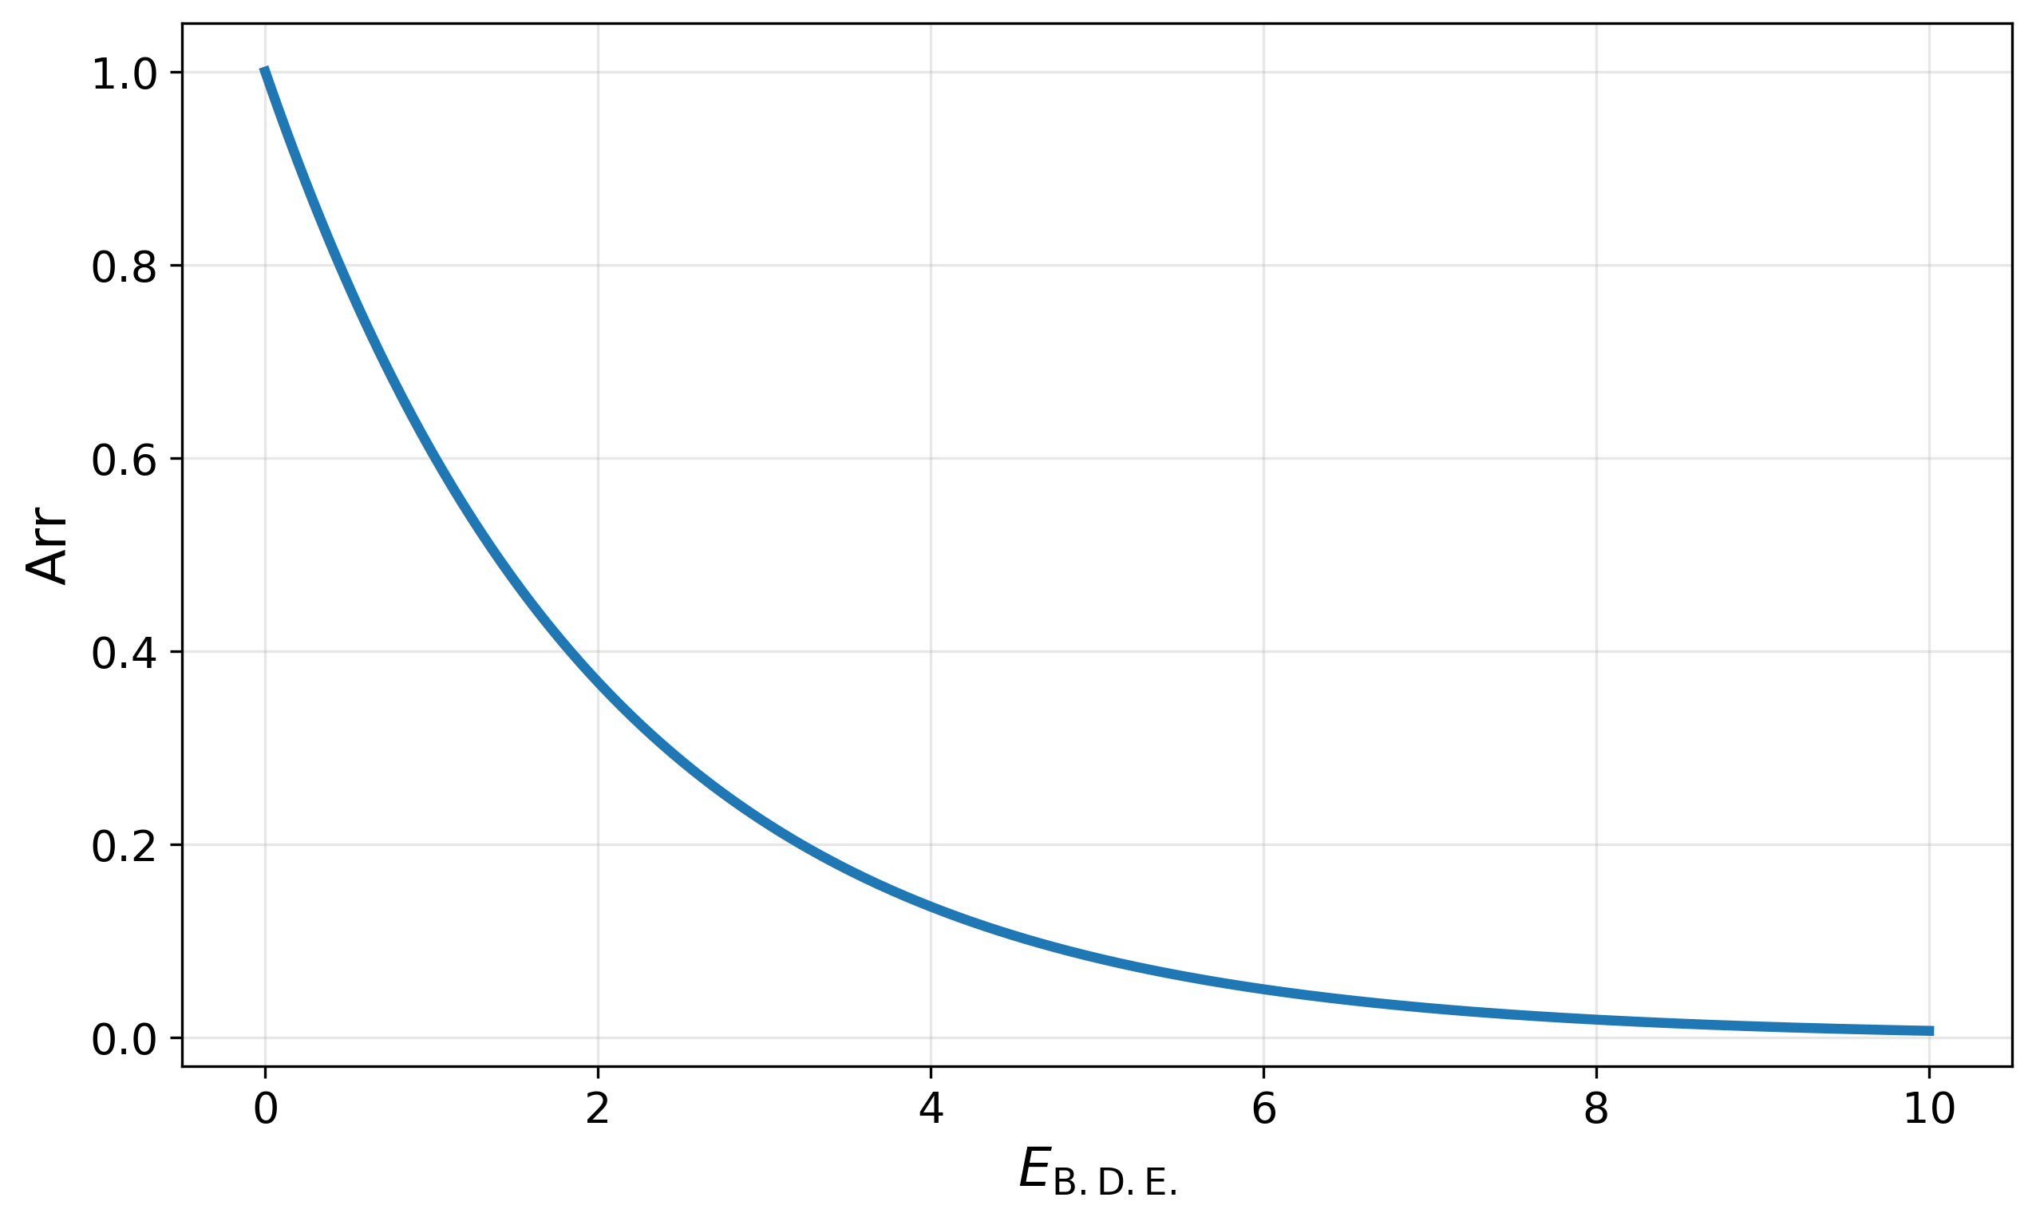
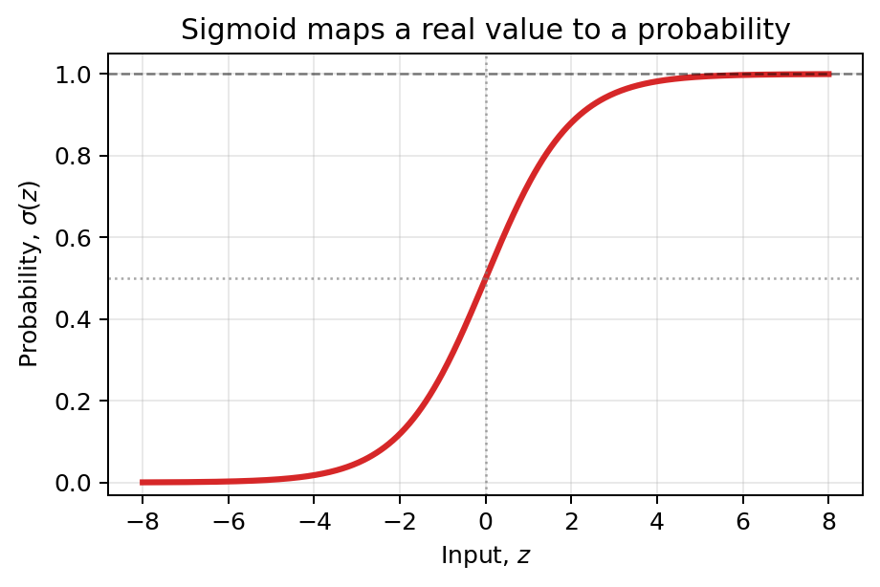

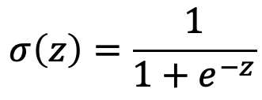
Mathematical model: available mathematical tools
Eq. 1: Arrhenius-like Equation
Eq. 2: Sigmoid Function
$$σ\left(z\right)=\frac{1}{1+e^{−z}}$$
$$Arr=αe^{−E_{B.D.E.}/β}$$
As bond dissociation energy increase, the Arr term drops.
Sigmoid function maps $z∈\left(−∞, ∞\right)$ to $σ∈\left(0,1\right)$

Slide 8
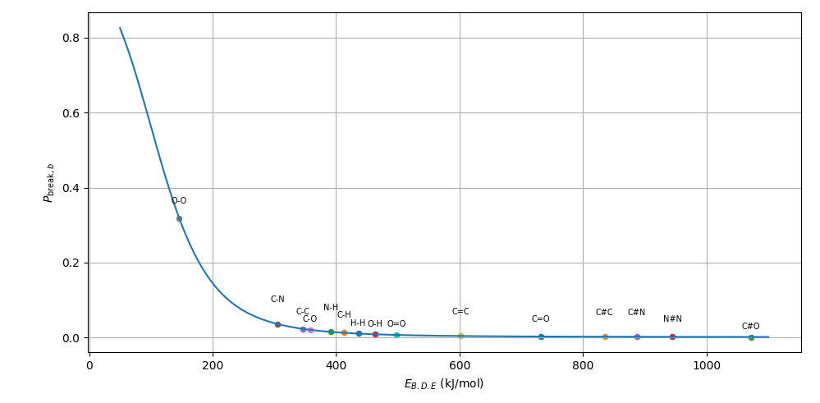
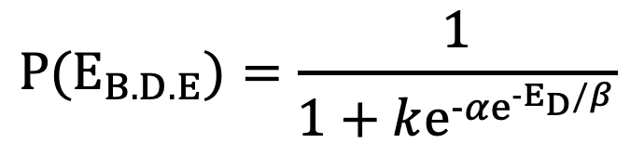
Mathematical model: final form
$$P(E_{B.D.E})=\frac{1}{1+ke^{−{αe}^{−E_{D}/β}}}$$
Schematic demonstration of the function
The probability for O-O bond breaking is much higher.
Lower bond breaking probability compared with skeletal bonds (Assumption II)
Very unlike to break but are constrained by valence rule.

Slide 9
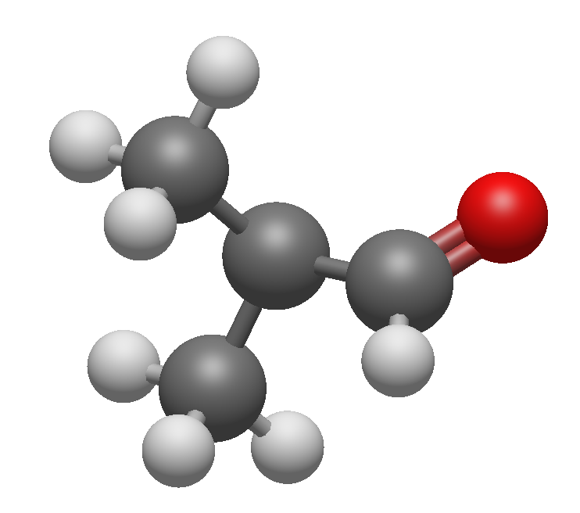
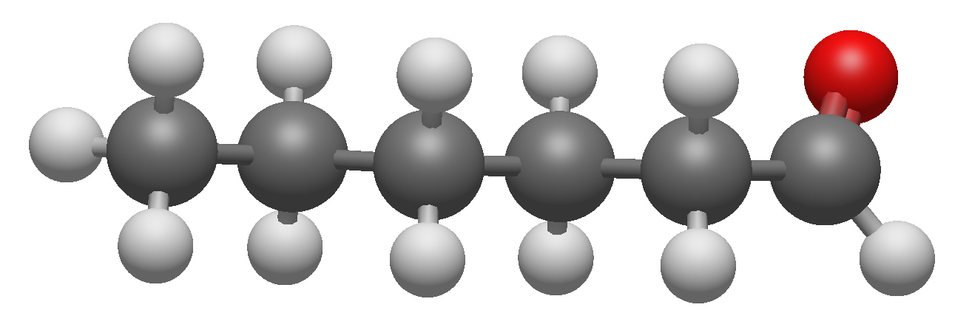
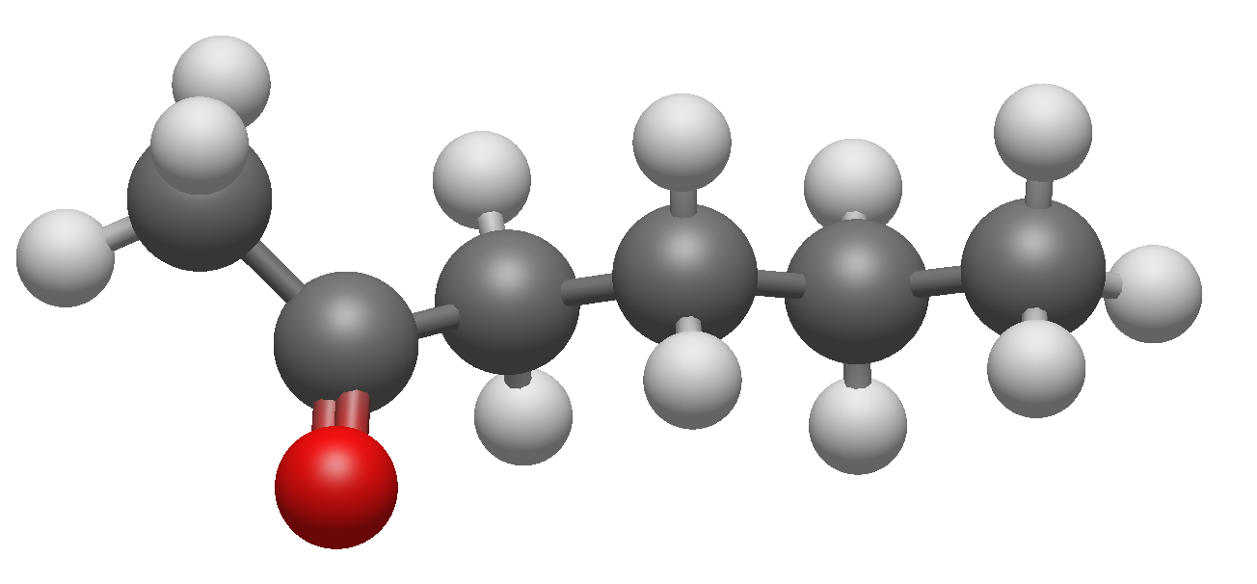
Fitting/Adjustable parameters (graphlet information)
C₄H₇O degeneracy
C₆H₁₂O degeneracy
2-hexanone
hexanal
Same degeneracies since they share same graphlet features
TC3H6OCHO
2-hexanone
Graphlet feature:
C-C 3
C=O 1
Graphlet feature:
C-C 5
C=O 1

Slide 10
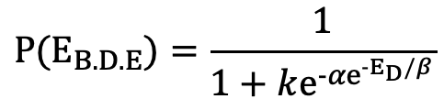
Fitting/Adjustable parameters (existing [positive] Data)
$$P(E_{B.D.E})=\frac{1}{1+ke^{−{αe}^{−E_{D}/β}}}$$
Tunable Parameters: $k$ $α$ $β$
Constant: $E_{D}$ (bond dissociation energy)
We chose two LLNL models as positive data pool:
LLNL C₈-C₁₆ detailed models
LLNL n-heptane detailed models
Then identifying each species backbones’ structure.

Slide 11
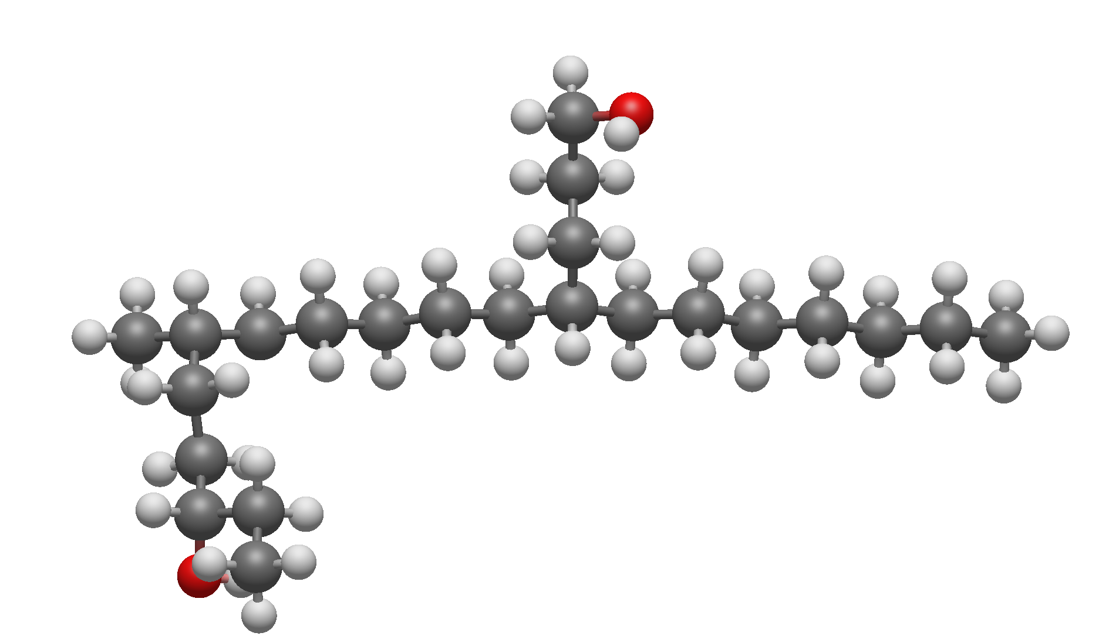
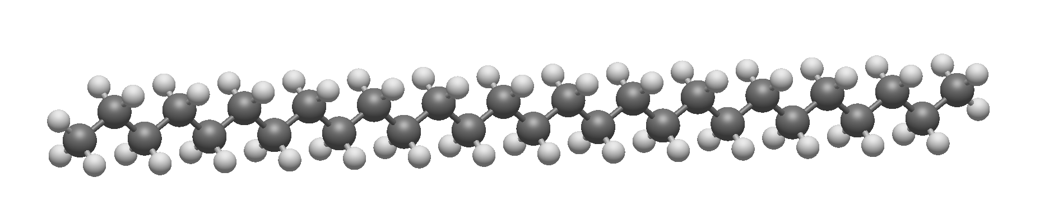
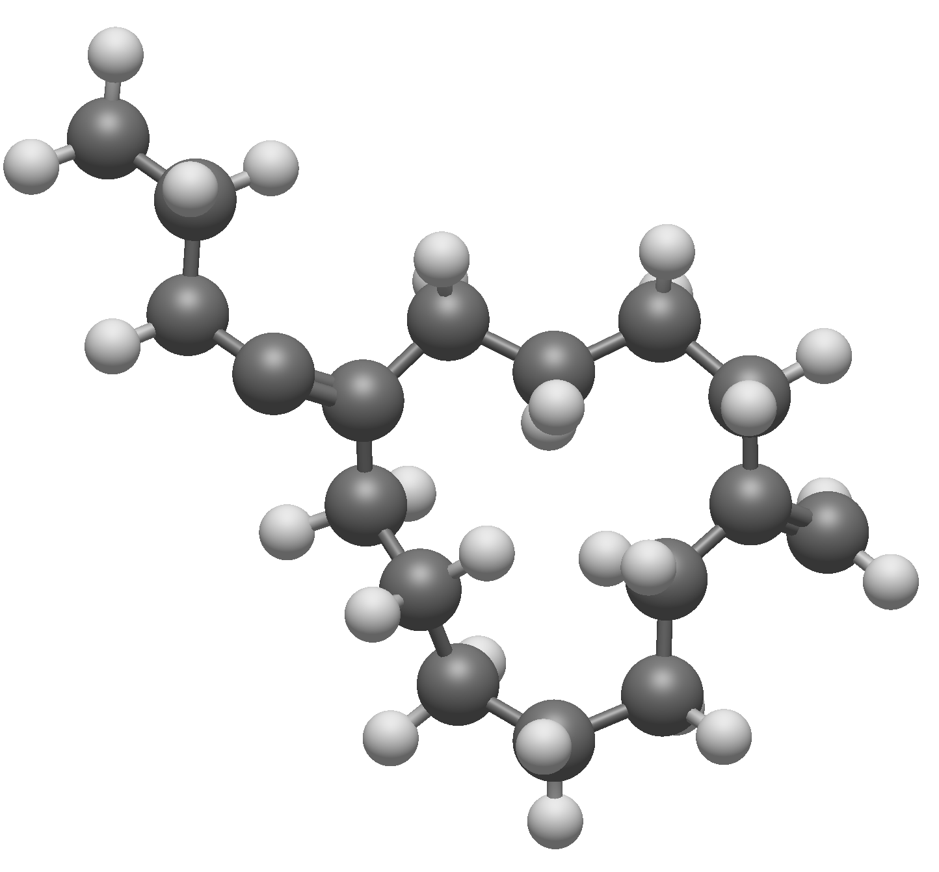
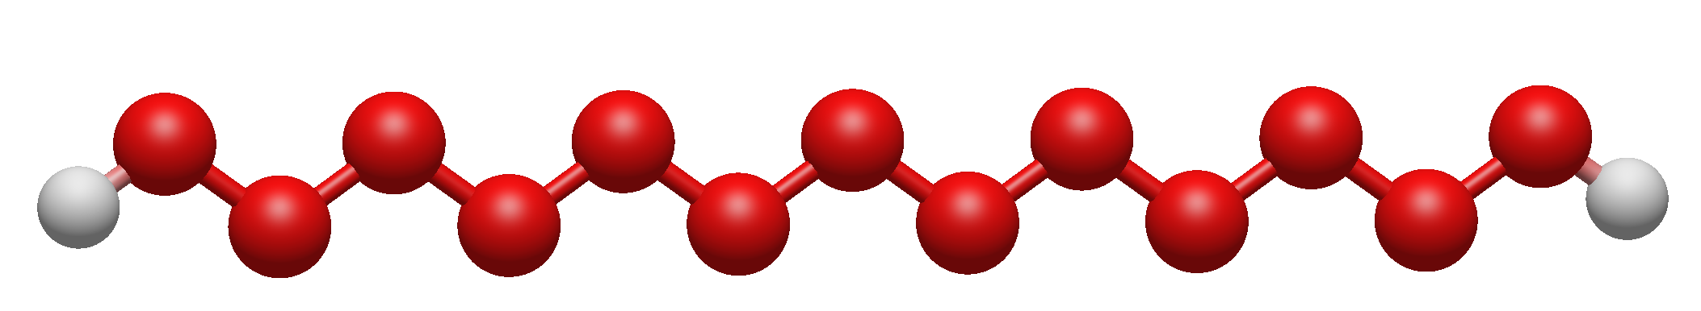
Fitting/Adjustable parameters (pseudo [negative] data)
$$P(E_{B.D.E})=\frac{1}{1+ke^{−{αe}^{−E_{D}/β}}}$$
Tunable Parameters: $k$ $α$ $β$
Constant: $E_{D}$ (bond dissociation energy)
Long chain alkane
Long branched alkane
Large carbon ring
Long chain hydroperoxyl

Slide 12





Fitting/Adjustable parameters (data summary & loss function)
Data for Fitting
Positive species from LLNL detail models 267 degeneracies
Synthesized pseudo negative species 569 degeneracies
Loss Function Construction
$$L=ζ\frac{1}{|P^{|}}\sum_{g∈P^{∗}}{ℓ_{+}}\left(g\right)+η\frac{1}{\left|N^{∗}\right|}\sum_{g∈N^{∗}}{ℓ_{−}}\left(g\right)+L_{reg}$$
$$ℓ_{+}\left(g\right)={\left[1−Pexist\left(g\right)\right]}^{2}$$
$$ℓ_{−}\left(g\right)={Pexist\left(g\right)}^{2}$$
Penalising L2 norms

Slide 13
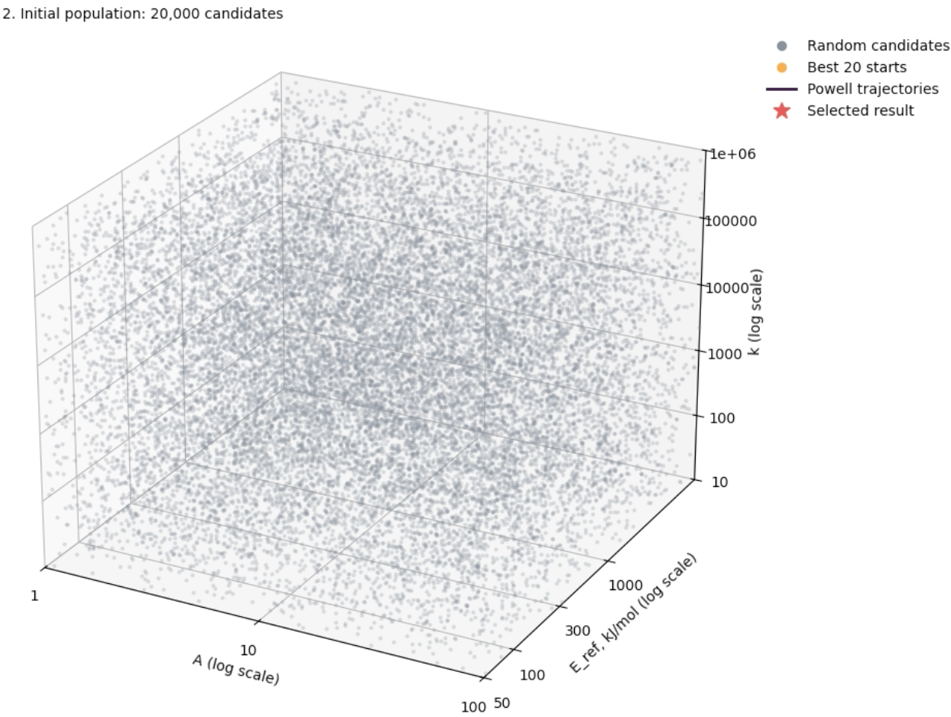
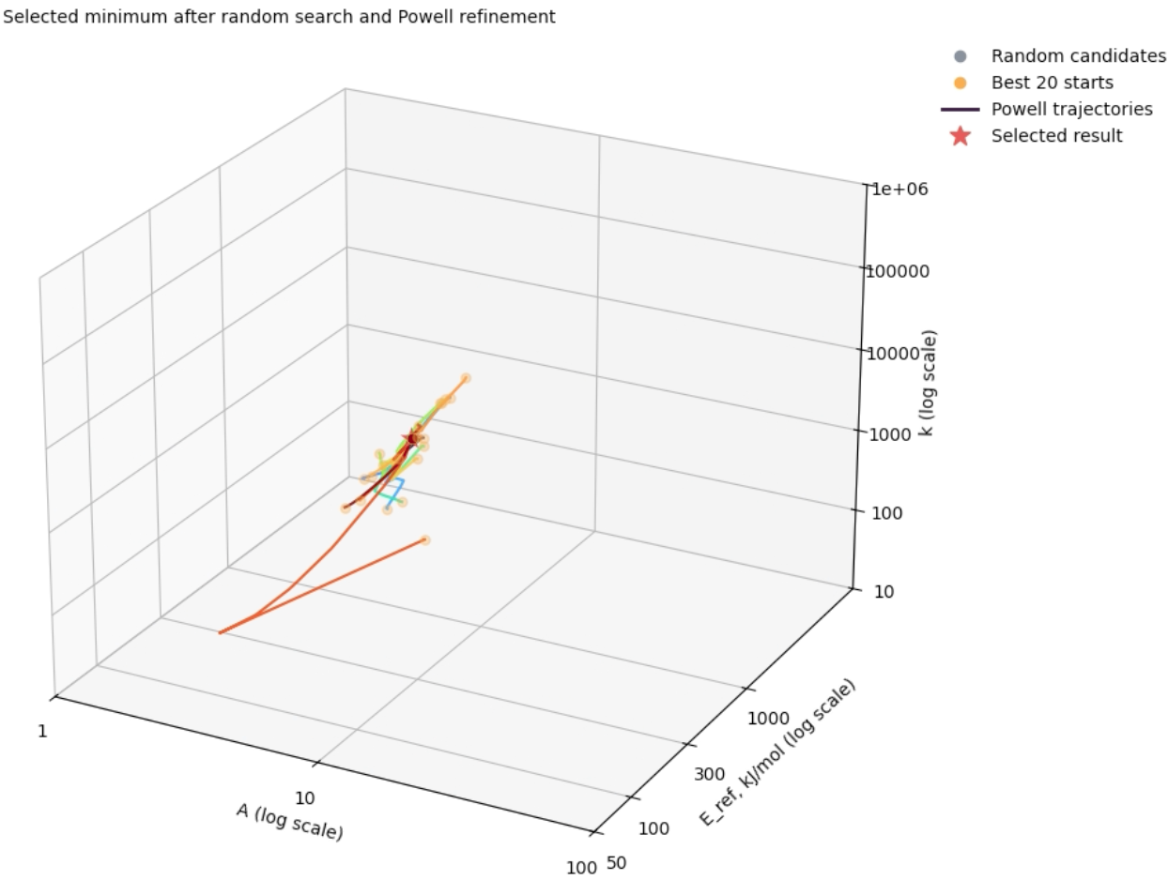
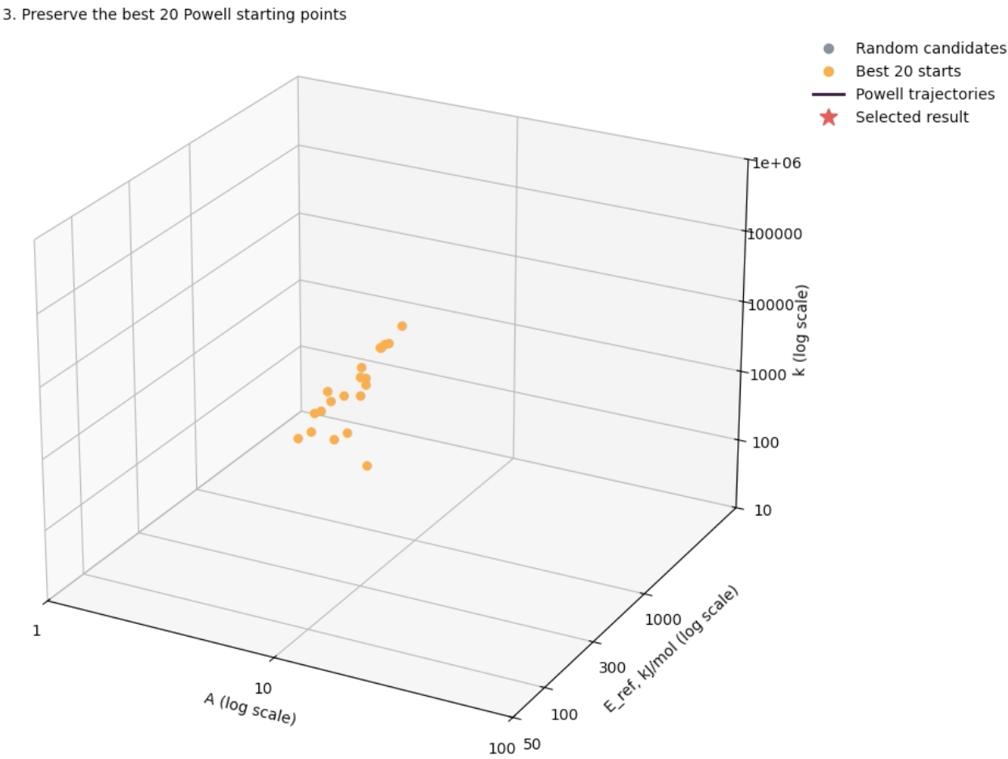
Fitting/Adjustable parameters (random search & Powell refinement)
Converged parameter set
Step 2: Preserve the best 20 candidates for Powell Refinement Starting point
Step 1: Randomly select 20,000 candidates in the parameter space.
Step 3: Conduct Powell Refinement and yield the converged parameter set.

Slide 14
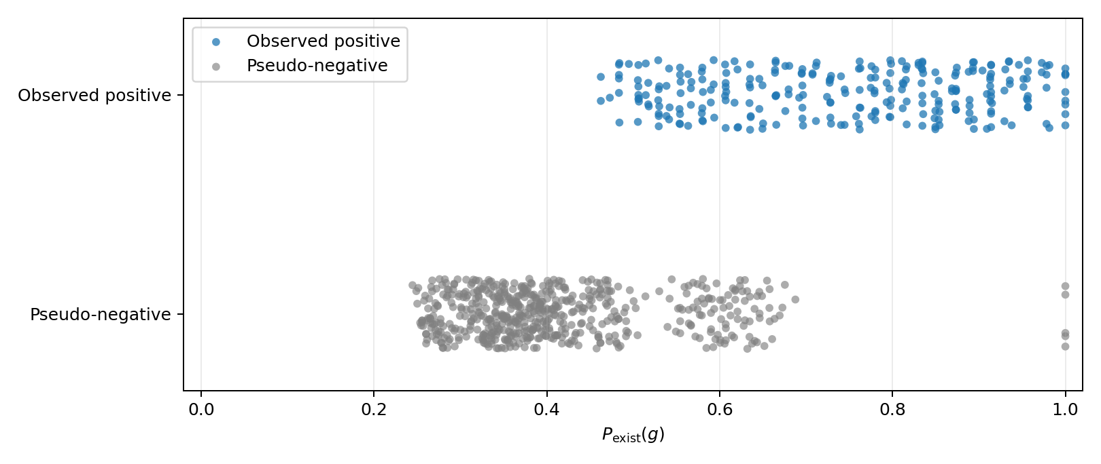
Fitting/Adjustable parameters (current output, need improvement)
Positive results generally yields higher scores
Bugs, fixing needed
Negative results generally yields lower scores

Slide 15
Next steps
Achieved: Established a mathematical penalty function based on bond dissociation energy information, which is expected to penalize the formation of long-chain hydroperoxyl (HOx) and long-chain carbon alkyl molecules
Next steps:
Further improve the mathematical penalty function parameters
The current algorithm for searching the parameter still needs improvement. A few pseudo-negative cases did not yield low existence scores
Implementing the pretrained reward/penalty into the loss function
By now we have node, edge level loss function for the GNN–reinforcement learning architecture. We will incorporate this subgraph/graphlet level loss function into the architecture, starting from the H/O system.
Repeat training with the addition of the graphlet level information from the GNN-RL architecture when new, “invalid” species are found.
Incorporate C/H/O system and observe polymer (e.g., polyethylene) or aromatic ring growth behavior.

